Slide 1
Cryptography and Network Security Chapter 8
Fourth Edition
by William Stallings
Lecture slides by Lawrie Brown
Notes:
Lecture slides by Lawrie Brown for “Cryptography and Network Security”, 4/e, by William Stallings, Chapter 8 – “Introduction to Number Theory”.

Slide 2
Introduction to Number Theory
Prime nos. A positive integer is said to be a prime no, if its only positive divisors are 1 and self. Eg., 2, 3, 5, 7, 11, …
Prime no has exactly 2 divisors(+ve)
1 neither prime nor composite
Integer factorization / prime factorization.
Unique factorization theorem. Every integer is either a prime or can be uniquely written as a product of primes
eg. 91=7x13 ; 3600=2⁴x3²x5²
Notes:
Opening quote. A number of concepts from number theory are essential in the design of public-key cryptographic algorithms, which this chapter will introduce.

Slide 3
Integer factorization problem is an intractable problem.
NFS and Pollard – rho are the only algorithms to solve this problem and they have sub-exponential / fully exponential running time complexity
Security of RSA is based on complexity of integer factorization.

Slide 4
Relatively prime or co-prime numbers
Two integers are said to be relatively prime, if the their GCD is 1
Eg., 10, 21 are relatively prime numbers
Use Euclidean algorithm to find GCD

Slide 5
Fermat's Theorem
a^{p-1} = 1 (mod p)
where p is prime and gcd(a,p)=1
also known as Fermat’s Little Theorem
also a^{p} = a (mod p)
useful in public key and primality testing
Notes:
Two theorems that play important roles in public-key cryptography are Fermat’s theorem and Euler’s theorem.
Fermat’s theorem (also known as Fermat’s Little Theorem) as listed above, states an important property of prime numbers. See Stallings section 8.2 for its proof.

Slide 6
Euler Totient Function ø(n)
Number of positive integers s.t
< n
Relatively prime to n
Eg., ø(10)=4, since {1,3,7,9} are the numbers satisfying both conditions.
If p is prime, ø(p)= p-1
If p and q are primes,
ø(pq)=ø(p)x ø(q) = (p-1)x(q-1)
eg.
ø(37) = 36
ø(21) = (3–1)x(7–1) = 2x6 = 12
Notes:
Now introduce the Euler’s totient function ø(n), defined as the number of positive integers less than n & relatively prime to n. Note the term “residue” refers to numbers less than some modulus, and the “reduced set of residues” to those numbers (residues) which are relatively prime to the modulus (n). Note by convention that ø(1) = 1.

Slide 7
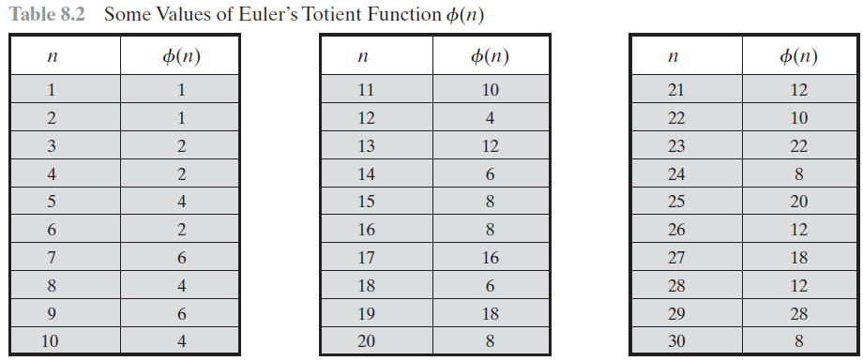

Slide 8
Euler's Theorem
a generalisation of Fermat's Theorem
a^{ø(n)} = 1 (mod n)
for any a,n where gcd(a,n)=1
eg.
a=3;n=10; ø(10)=4;
hence 3⁴ = 81 = 1 mod 10
a=2;n=11; ø(11)=10;
hence 2¹⁰ = 1024 = 1 mod 11
Notes:
Euler's Theorem is a generalization of Fermat's Theorem for any number n. See Stallings section 8.2 for its proof.

Slide 9
Primality Testing
Traditionally, sieve using trial division (brute force)
ie. divide by all numbers (primes) in turn less than the square root of the number
only works for small numbers
Miller Rabin algorithm (old)
AKS primality testing algorithm (latest)
Notes:
For many cryptographic functions it is necessary to select one or more very large prime numbers at random.
Thus we are faced with the task of determining whether a given large number is prime.
Traditionally sieve for primes using trial division of all possible prime factors of some number, but this only works for small numbers.
Alternatively can use repeated statistical primality tests based on properties of primes, and then for certainty, use a slower deterministic primality test, such as the AKS test.

Slide 10
Primitive Roots
By Euler’s theorem, a^{ø(n)} = 1(mod n)
consider a^{m}=1 (mod n), GCD(a,n)=1
must exist for m = ø(n) but may be for smaller value of m
once powers reach m, cycle will repeat
if smallest is m = ø(n) then a is called a primitive root
Notes:
Consider the powers of an integer modulo n. By Eulers theorem, for every relatively prime a, there is at least one power equal to 1 (being ø(n)), but there may be a smaller value. If the smallest value is m = ø(n) then a is called a primitive root. If n is prime, then the powers of a primitive root “generate” all residues mod n. Such generators are very useful, and are used in a number of public-key algorithms, but they are relatively hard to find.

Slide 11
a is a primitive root of n iff a % n, a² % n, …, a^{φ(n)} % n are distinct and coprime to n (Equivalently, order of a is φ(n))
Example: 7 is a primitive root of 23, since 7 % 23, 7² % 23, …, 7^{φ(23)} % 23 are distinct and coprime to 23
7 is a primitive root of 13, since 7 % 13, 7² % 13, …, 7^{φ(13)} % 13 are 7, 10, 5, 9, 11, 12, 6, 3, 8, 4, 2, 1 respectively which are distinct & coprime to 13

Slide 12
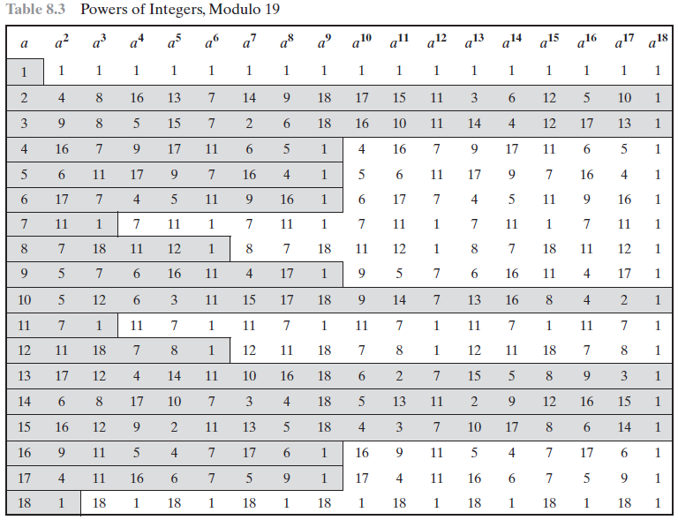

Slide 14
Discrete Logarithms
the inverse problem to exponentiation is to find the discrete logarithm of a number modulo p
that is to find x such that y = g^{x} (mod p)
this is written as x = log_{g} y (mod p)
whilst exponentiation is relatively easy, finding discrete logarithms is generally a hard problem
Notes:
Discrete logarithms are fundamental to a number of public-key algorithms, including Diffie-Hellman key exchange and the digital signature algorithm (DSA).
Discrete logs (or indices) share the properties of normal logarithms, and are quite useful. The logarithm of a number is defined to be the power to which some positive base (except 1) must be raised in order to equal that number. If working with modulo arithmetic, and the base is a primitive root, then an integral discrete logarithm exists for any residue.
However whilst exponentiation is relatively easy, finding discrete logs is not, in fact is as hard as factoring a number. This is an example of a problem that is "easy" one way (raising a number to a power), but "hard" the other (finding what power a number is raised to giving the desired answer). Problems with this type of asymmetry are very rare, but are of critical usefulness in modern cryptography.

Slide 15
Summary
have considered:
prime numbers
Fermat’s and Euler’s Theorems & ø(n)
Primality Testing
Discrete Logarithms
Notes:
Chapter 8 summary.

